Slide 1

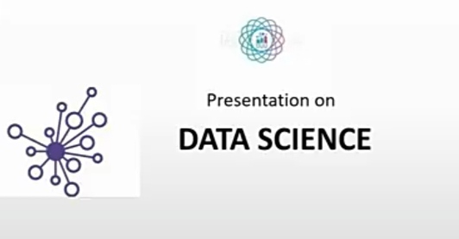
GYATRI INSTITUTE OF COMPUTER AND MANAGEMENT
Presented by:-
Ansuman Mishra

Slide 2

Table of content
Why study data Science ?
What is data science ?
Application of data Science ?
What is data visualization ?
Role of data science in our daily life ?
Conclusion

Slide 3
Why study data Science ?
Data science play a major role in in various platform but it mostly uses in business world.
Provides meaningful information based on large amounts of complex data or big data.
Have ability to deals with non-linear data.
It is very helpful that.
we are able to think in structured way.
we like to solve big data related problem.
we are good at mathematic.
we have some knowledge of Programing.

Slide 4

What is data science ?
Data science is we do some scientific calculation on data to get suitable out put, beneficial one.
The field of bringing out insight from data using scientific techniques is called data science.
DATA SCIENCE = DATA+SCIENCE
Data science is multi display field that deals with knowledge and unstructured data sets.

Slide 5
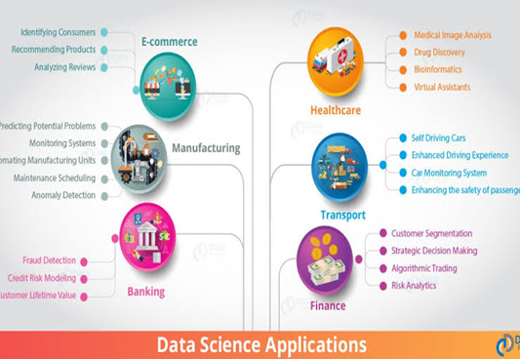
Application of data Science ?
Identifying and predicting disease
Personalized healthcare recommendations
Optimizing shipping routes in real-time
Stamping out tax fraud
Automating digital and placement

Slide 6
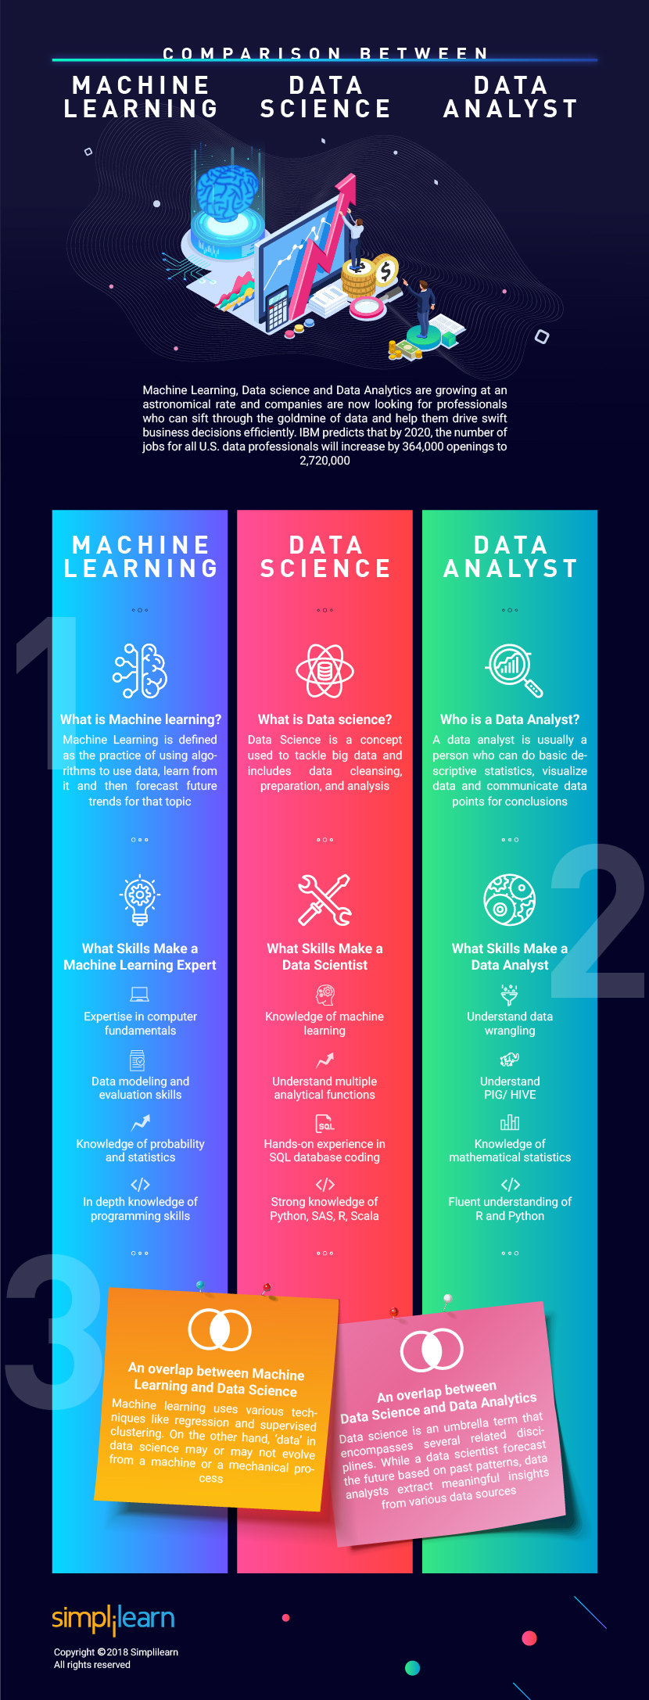
What is data visualization ?
Data visualization is the graphical representation of information and data. By using visual elements like charts, graphs, and maps, data visualization tools provide an accessible way to see and understand trends, outliers, and patterns in data.
In the world of Big Data, data visualization tools and technologies are essential to analyze massive amounts of information and make data-driven decisions.

Slide 7



Role of data science in our daily life ?
With the help of data science technologies, banking companies are now able to divide and conquer data through past expenditures, customer profiling together with other variables for analyzing the probabilities of default and risk. They’re also leveraging the role of data science to prevent financial fraud. Now, banks can successfully track and trace credit card fraud, the breach of important financial data, and any other suspicious activity by leveraging data science tools and technologies.

Slide 8

conclusion
Data science education is well into its formative stages of development; it is evolving into a self-supporting discipline and producing professionals with distinct and complementary skills relative to professionals in the computer, information, and statistical sciences.

Slide 9

Thank you…

