Slide 1

SEMINAR ON
PARENTAL CONTROL

Slide 2
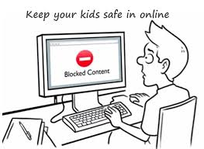
WHAT IS PARENTAL CONTROL ?
Parental controls are features or software that allow you to monitor and restrict what a person does online.
They are a great way to prevent children from
accessing unsuitable
content online .

Slide 3



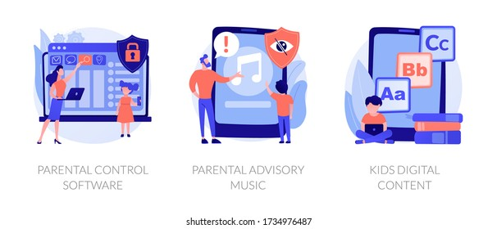
What can we do with this !

Slide 4
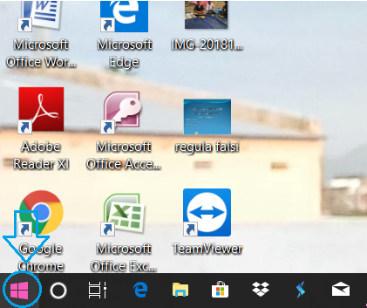
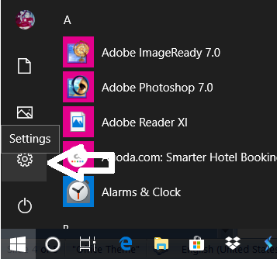
Steps of how to set up parental control
Click on start button .
The choose Settings. Windows Settings will open. n click on

Slide 5
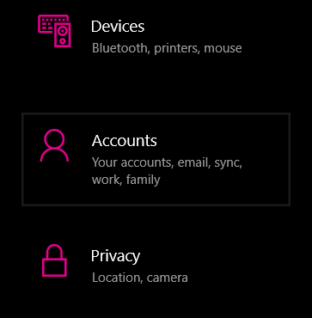
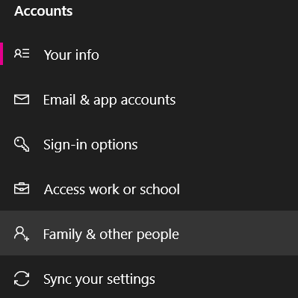
Select Accounts. The Accounts window will open.
In the left pane, select Family & Other Users. The Family & Other Users window will open.

Slide 6
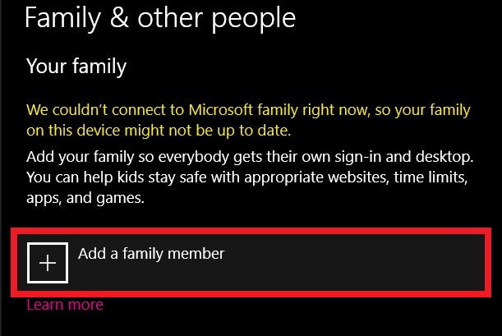
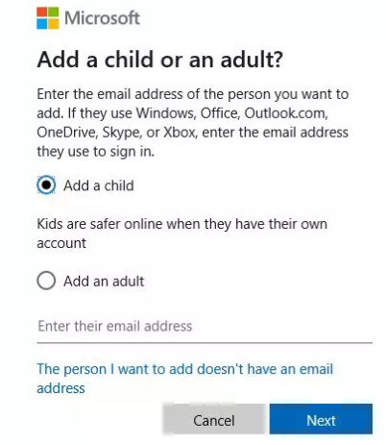
Select Add a Family Member if your child does not have a separate account on your device. A Microsoft Account window will pop up.
Select Add a Child and then choose The Person I Want To Add Doesn’t Have An Email Address. (If they do have an email address, type it. Then skip to Step 6.)

Slide 7
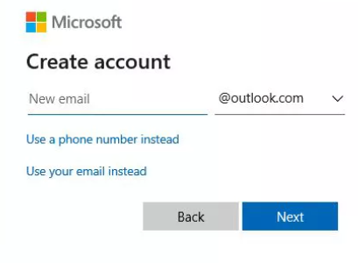
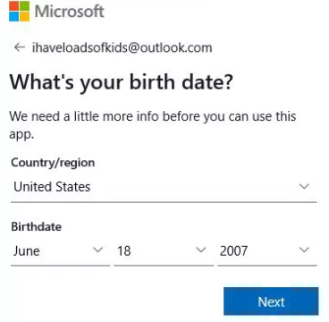
In the Let’s Create An Account dialog box, type the required information including an email account, password, country, and birth date.
Select Next. Choose Confirm if prompted.

Slide 8
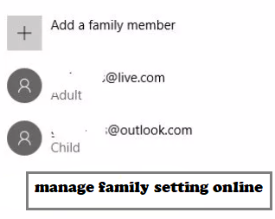
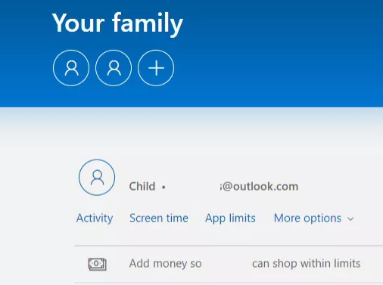
then choose Manage Family Settings Online.
Log in if prompted, and then locate the child account from the list of accounts included with your family.

Slide 9
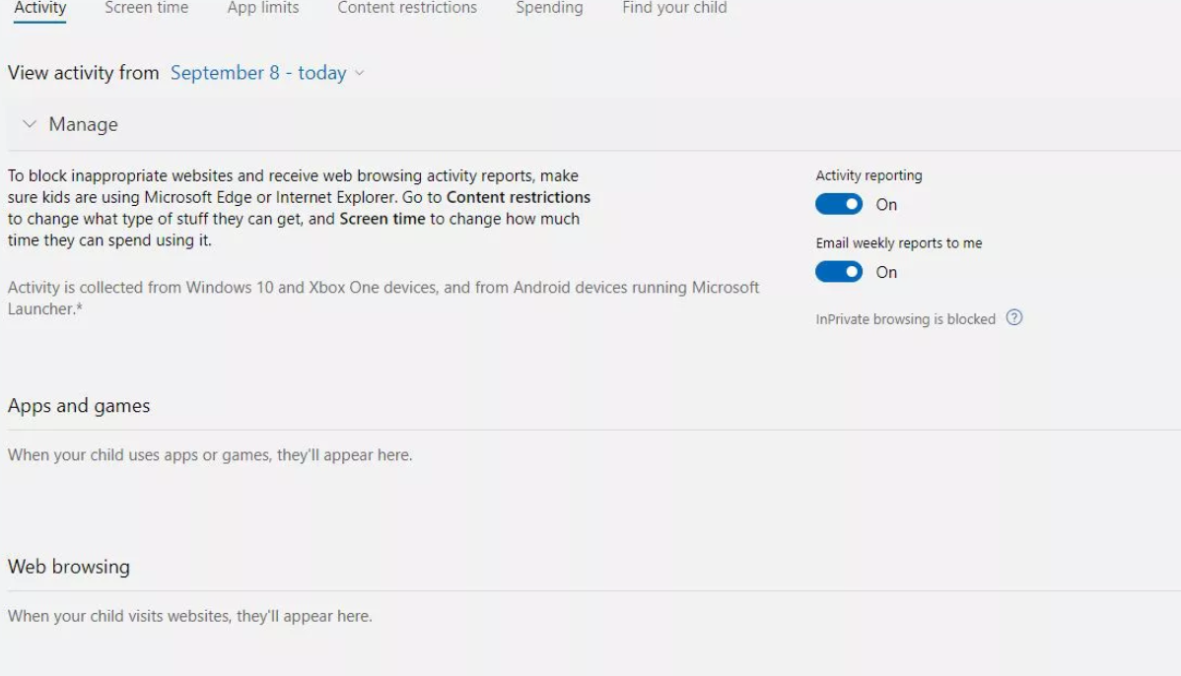
Click on the activity option .

Slide 10
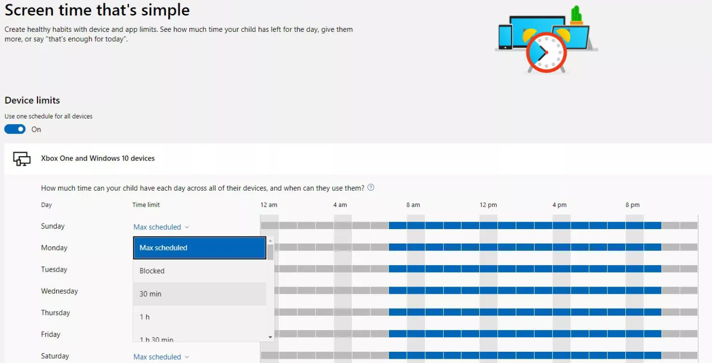
Select Screen Time below your child's name to open the Screen Time tab. Make changes to the default Screen Time Settings using the drop-down lists and daily timelines.

Slide 11
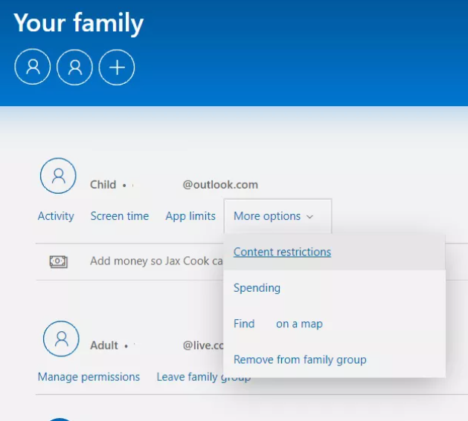
Select More Options under your child's name and choose Content Restrictions.

Slide 12
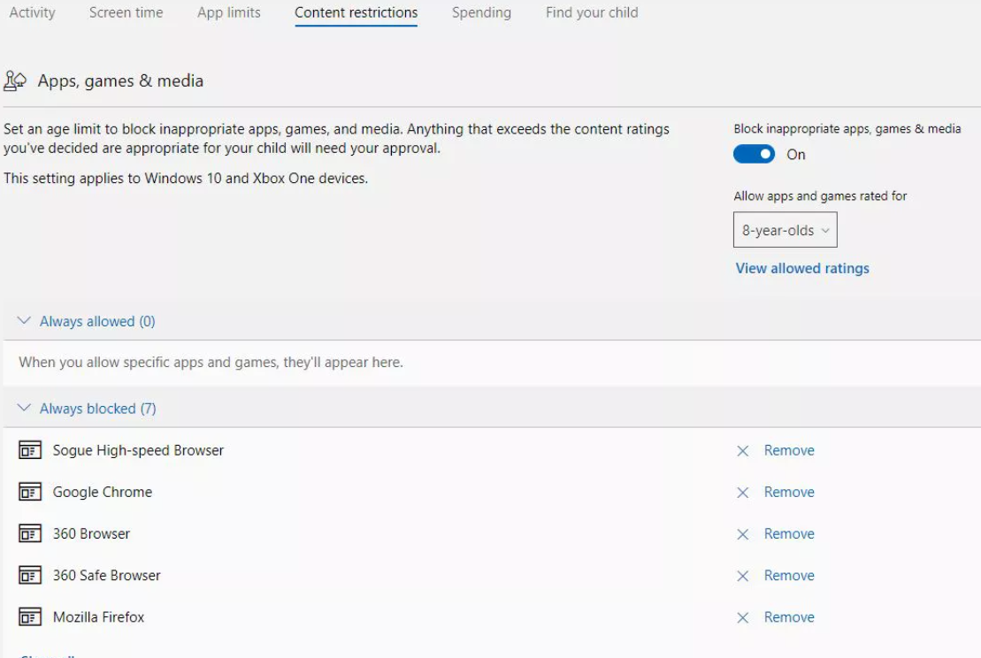
Make sure Block Inappropriate Apps And Games and Block Inappropriate Websites are enabled. Add any apps or websites you wish to block or allow and select an appropriate age rating.

Slide 13
To block inappropriate websites and receive web browsing activity reports, your child must use Edge or Internet Explorer. You can block other browsers.
Continue to explore other settings as desired.

Slide 14
THANK YOU

